Slide 1

Writing Effective Syllabi and Lesson Plans for Student Success
Presenter: Alicia Buck, MS, BAAS, CST
Program Director & Associate Professor: Surgical Technology
Temple College, Temple TX

Slide 2

Presentation Objectives
  Define the difference between course goals, objectives & outcomes.
  Discuss areas of required course / program outcomes.
  Identify module / unit specific outcomes.
  Discuss lesson plans focused on course outcomes.
  Review assessments that reflect course goals, objectives and outcomes

Slide 3


Slide 4
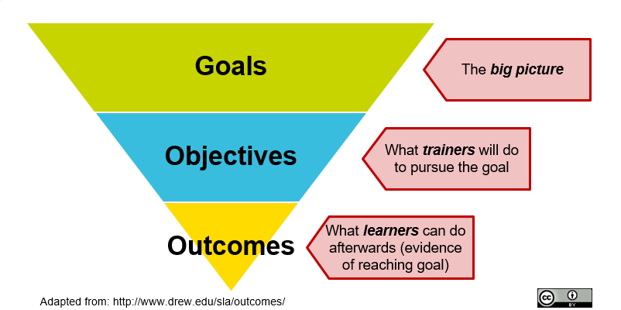
Technically……. There is a Difference
Objectives and outcomes are typically used interchangeably but differ in the level of learning that occurs from lower level (teacher driven) to higher level (application by learner).

Slide 5
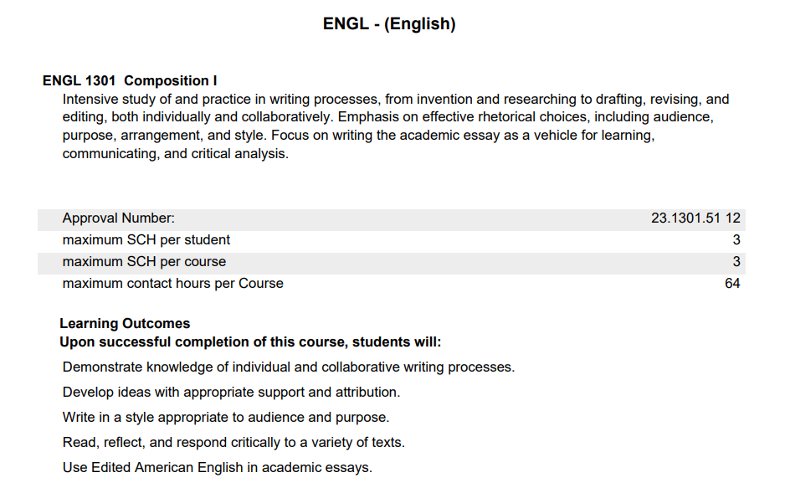
Ensure Your Goals & Outcomes Align with Standards
State Common Course Inventory
Program Core Curriculum
Program Advisory Committee / Community Needs
Marketable Skills
Texas Higher Education Coordinating Board Course Inventory Report, Retrieved May 17th, 2024

Slide 6
What is a Learning Objective and Why is it Important to my Student’s Success?
Organized statements of observable student behaviors or actions
SMART
Specific
Measurable
Attainable
Relevant
Time-Bound
Provides direction and focus for self-regulated learning and student success

Slide 7
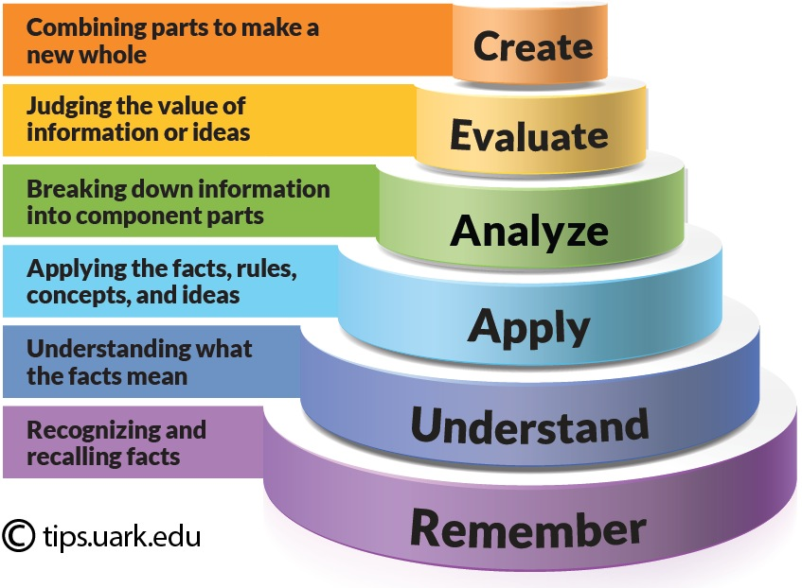
Module / Unit Specific Objectives / Outcomes
Clusters of related topics and statements
Answers the Following:
Who
Will do
How much / How well
Of what
By when
Use of Bloom’s Taxonomy

Slide 8
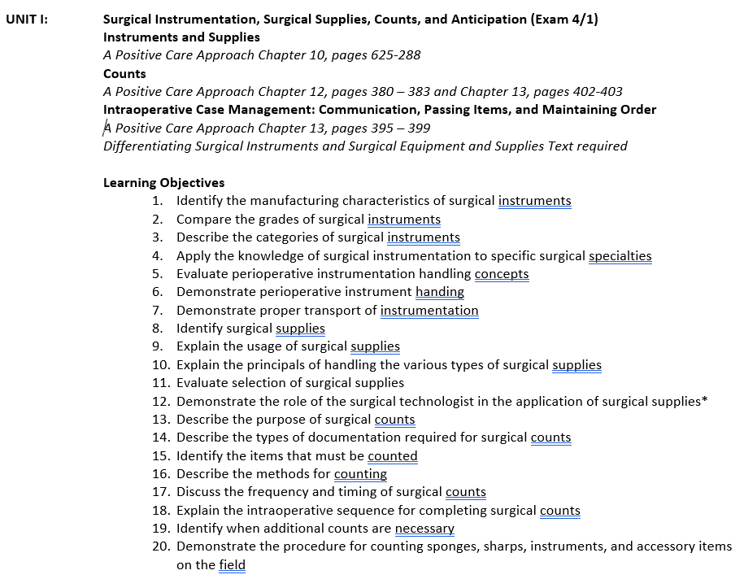

Slide 9
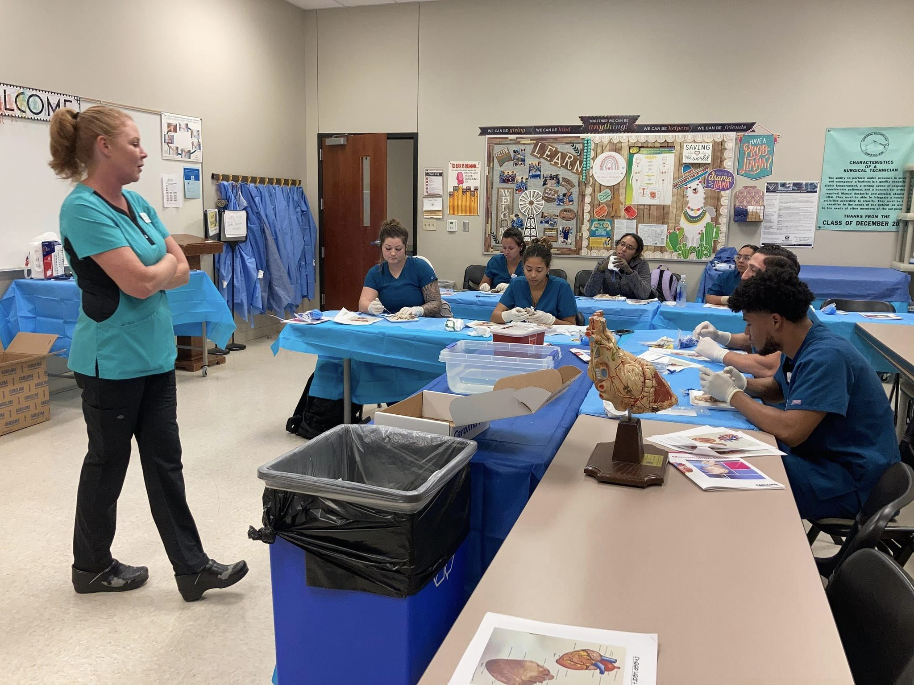
How Many Have Heard This!?
Student, “Mrs. Buck, are you gonna give us a test review?”
Me, “Why, student, that is what I have been doing all week!”

Slide 10

Lesson Plans and
Instructional Alignment
Choosing an Instructional Method
  Reflective and Relevant of Learning Objective & Outcomes
  Time and Resources Available

Slide 11
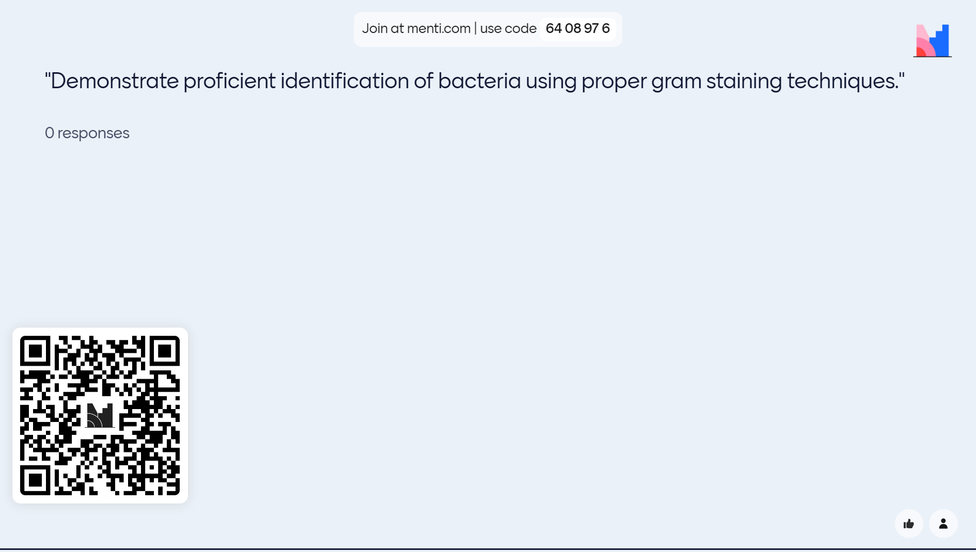

Slide 12
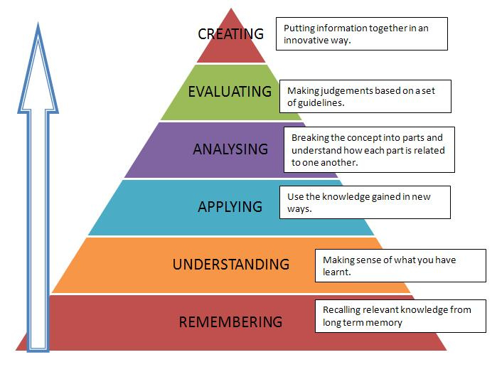
Use of Domain Levels to Structure Lesson Plan
Higher Level Outcomes Require Objective Scaffolding:
  Define gram staining
  Describe the difference between gram – and gram +
  Operate a microscope
  Compare staining agents

Slide 13
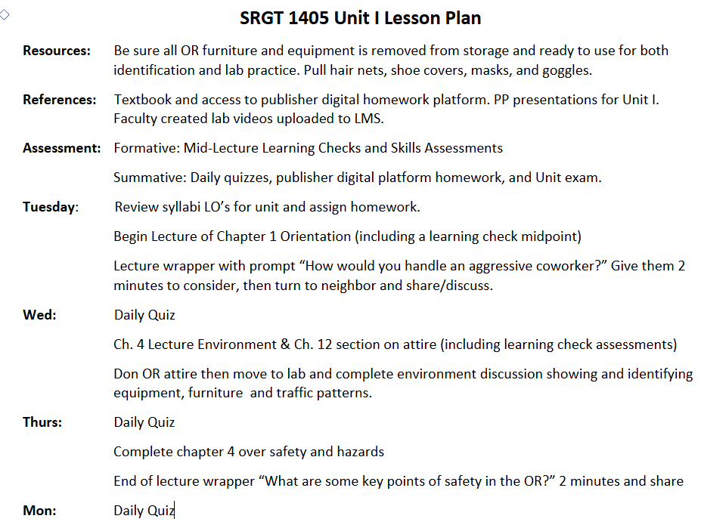
Lesson Plan Basics
Objectives & Outcomes
Can refer back to syllabi
Resources
References & Materials
Assessments
Activities
Timeline

Slide 14
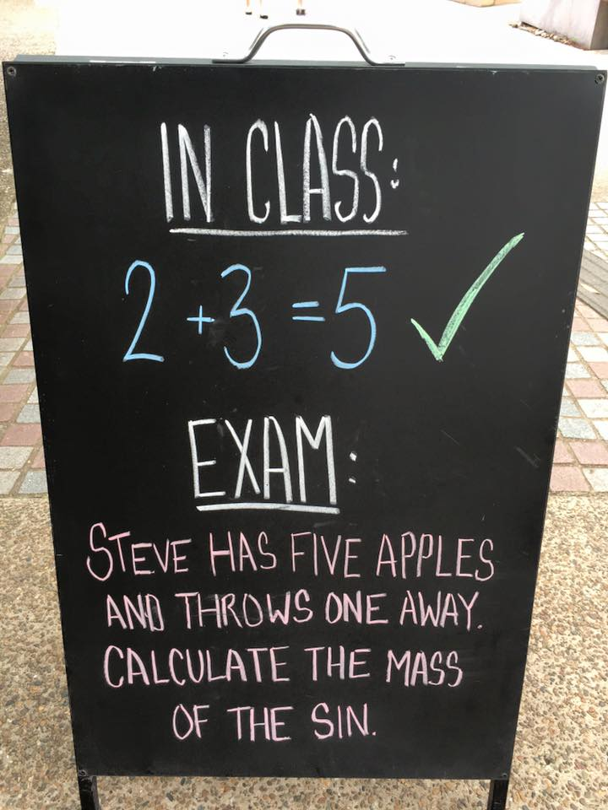
Assessments
Frequent
Formative
Summative
Relevant
Specific to Module / Unit Topic
Reflective
Lower-level & higher-level domain questions / activities

Slide 15

What About Distance Ed / Online Learning?
Objectives & Outcomes may need to be adjusted to reflect delivery
  How could the cognitive process and objective adjust?
A minimum of 2 Substantiative Interactions Must Occur
  Opportunity!

Slide 16


